Slide 1
CS 463 Natural Language Processing
Dr. Saleh Haridy
2022-2023

Slide 2
Text classification using logistic regression
Notes:
In this lecture we talk about the difference between generative and discriminative classifiers, and the relationship between Naïve Bayes and Logistic Regression.

Slide 3
Logistic Regression
Important analytic tool in natural and social sciences
Baseline supervised machine learning tool for classification
Is also the foundation of neural networks, feedforward NN can be considered as a stack of logistic regression classifiers.

Slide 4
Generative and Discriminative Classifiers
Naive Bayes is a generative classifier
by contrast:
Logistic regression is a discriminative classifier

Slide 5


Generative and Discriminative Classifiers
Suppose we're distinguishing cat from dog images
imagenet
imagenet

Slide 6
Generative Classifier:
Build a model of what's in a cat image
Knows about mustaches, ears, eyes
Assigns a probability to any image:
how cat-y is this image?
Also build a model for dog images,
what things make animal like a dog
Now given a new image:
Run both models (cat and dog classifiers)
and see which one fits better

Slide 7
Discriminative Classifier
Just try to distinguish dogs from cats
Oh look, dogs have long ears!
Let's ignore everything else

Slide 8
Finding the correct class c from a document d in Generative vs Discriminative Classifiers
Naive Bayes
Logistic Regression
posterior
P(c|d)
Directly compute the posterior probability of class

Slide 9
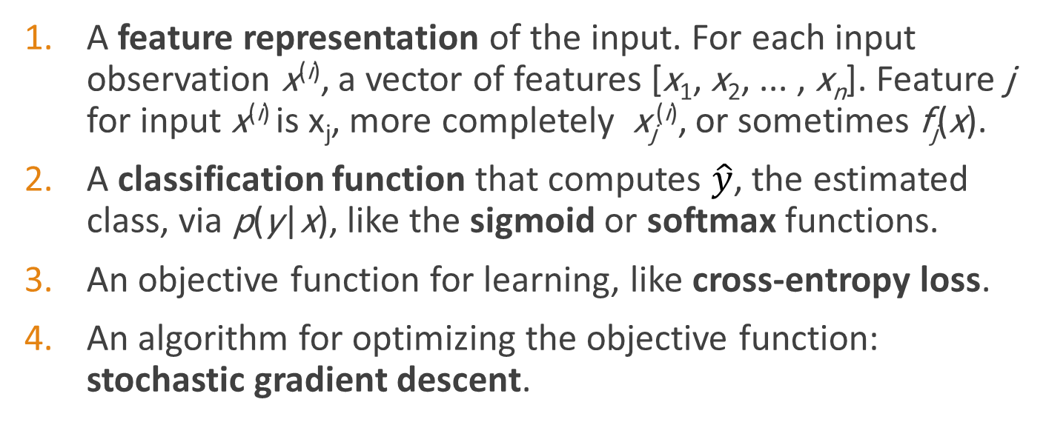
Components of a probabilistic machine learning classifier
Given m input/output pairs (x^{(i),}y^{(i)}):
A feature representation of the input. For each input observation x^{(i)}, a vector of features [x₁, x₂, ... , x_{n}]. Feature j for input x^{(i)} is x_{j}, more completely x_{j}^{(i)}, or sometimes f_{j}(x).
A classification function that computes $\hat{y}$, the estimated class, via p(y|x), like the sigmoid or softmax functions.
An objective function for learning, like cross-entropy loss.
An algorithm for optimizing the objective function: stochastic gradient descent.

Slide 10
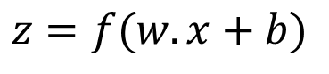
The two phases of logistic regression
$$z=f(w.x+b)$$
Training: we learn weights w and b using stochastic gradient descent and cross-entropy loss.
Test: Given a test example x we compute p(y|x) using learned weights w and b, and return whichever label (y = 1 or y = 0) is higher probability

Slide 11
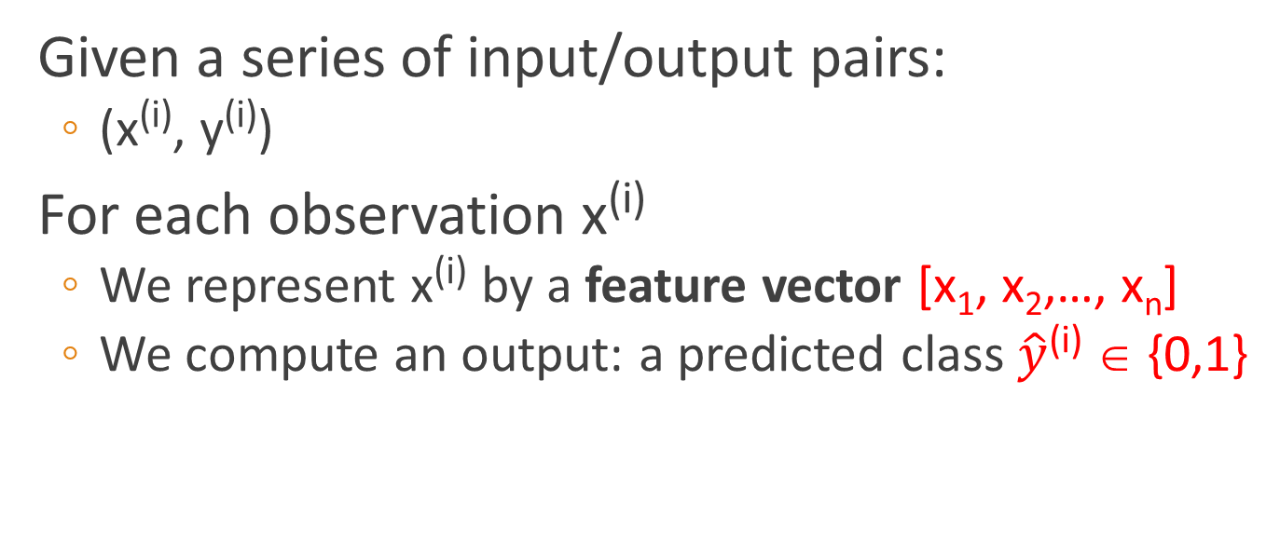
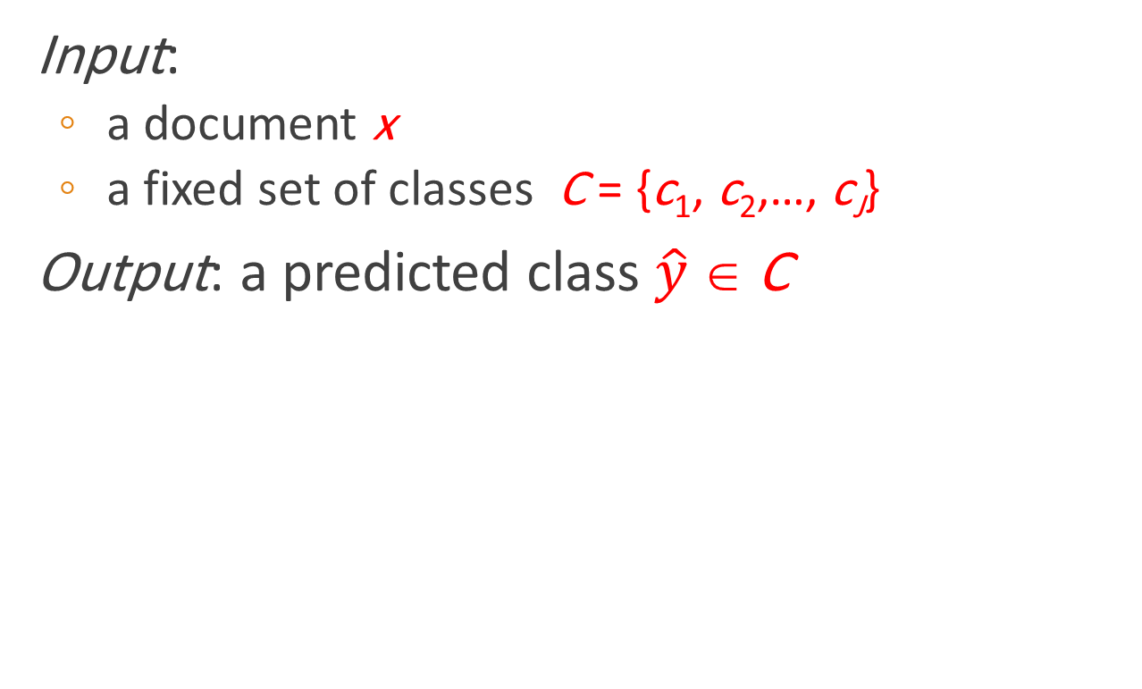
Text Classification: definition
Input:
a document x
a fixed set of classes C = {c₁, c₂,…, c_{J}}
Output: a predicted class $\hat{y}$ ∈ C
Given a series of input/output pairs:
(x^{(i)}, y^{(i)})
For each observation x^{(i)}
We represent x^{(i)} by a feature vector [x₁, x₂,…, x_{n}]
We compute an output: a predicted class $\hat{y}$^{(i)} ∈ {0,1}

Slide 12
Features in logistic regression
For feature x_{i}, weight w_{i} tells is how important is x_{i}
Assume that we build a sentiment classifier from user reviews, review contains the following words
x_{i} =‘awesome’: w_{i} = +10
x_{j} = ‘terrible’: w_{j} = -10
x_{k} = ‘ordinary’: w_{k} = -2
Notes:
The weight wi represents how important that input feature is to the classification decision, and can be positive (providing evidence that the in- stance being classified belongs in the positive class) or negative (providing evidence that the instance being classified belongs in the negative class). Thus we might expect in a sentiment task the word awesome to have a high positive weight, and abysmal to have a very negative weight.

Slide 13
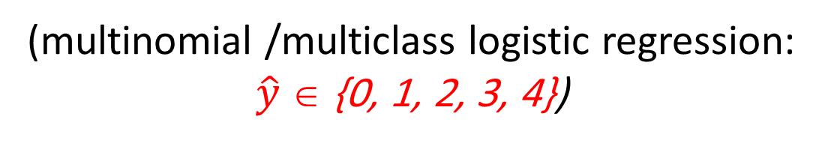
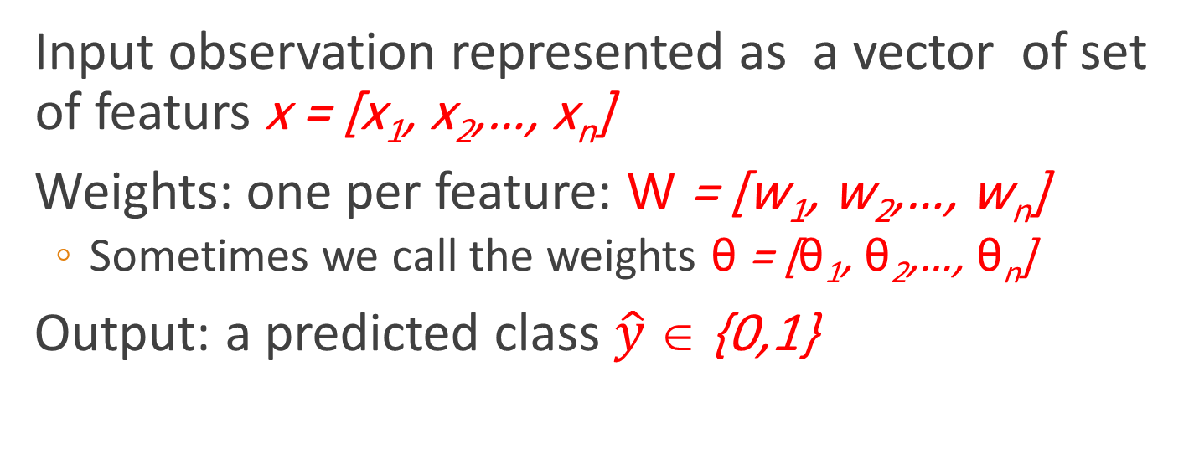
Logistic Regression for one observation x
Input observation represented as a vector of set of featurs x = [x₁, x₂,…, x_{n}]
Weights: one per feature: W = [w₁, w₂,…, w_{n}]
Sometimes we call the weights θ = [θ₁, θ₂,…, θ_{n}]
Output: a predicted class $\hat{y}$ ∈ {0,1}
(multinomial /multiclass logistic regression:
$\hat{y}$ ∈ {0, 1, 2, 3, 4})

Slide 14
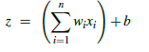
How to do classification
For each feature x_{i}, weight w_{i} tells us importance of x_{i}
(Plus we'll have a bias b)
We'll sum up all the weighted features and the bias
If this sum is high, we say y=1; if low, then y=0
Represented as dot product of two vectors
This is the linear regression model, how to convert it to a logistic regression
Notes:
The bias term, also called the intercept, is another real number that’s added to the weighted inputs. In the rest of the book we’ll represent such sums using the dot product notation from linear algebra. The dot product of two vectors a and b, written as a · b is the sum of the products of the corresponding elements of each vector.

Slide 15
But we want a probabilistic classifier
We need to formalize “sum is high”.
We’d like a principled classifier that gives us a probability, just like Naive Bayes did
We want a model that can tell us:
p(y=1|x; θ)
p(y=0|x; θ)
The problem: z isn't a probability, it's just a number!
Solution: use a sigmoid/logistic function of z that goes from 0 to 1

Slide 16
The very useful sigmoid or logistic function
Notes:
The sigmoid function The 1/1+e^-z (so-named because it looks like an s) is also called the logistic function. It takes a real value and maps it to the range [0, 1
It is nearly linear around 0 but outlier values get squashed toward 0 or 1.

Slide 17
Idea of logistic regression
We’ll compute w∙x+b
And then we’ll pass it through the sigmoid function:
σ(w∙x+b)
And we'll just treat it as a probability

Slide 18
Making probabilities with sigmoids
Notes:
We’re almost there. If we apply the sigmoid to the sum of the weighted features, we get a number between 0 and 1. To make it a probability, we just need to make sure that the two cases, p(y = 1) and p(y = 0), sum to 1. We can do this as follows:

Slide 19
By the way:
=
Because
Turning a probability into a decesion
0.5 here is called the decision boundary
Notes:
The sigmoid function has the property

Slide 20
The probabilistic classifier
P(y=1)
wx + b
if w∙x+b > 0
if w∙x+b ≤ 0

Slide 21
Sentiment example: does y=1 or y=0?
It's hokey . There are virtually no surprises , and the writing is second-rate . So why was it so enjoyable ? For one thing , the cast is great . Another nice touch is the music . I was overcome with the urge to get off the couch and start dancing . It sucked me in , and it'll do the same to you .
This is movie review text
Notes:
Suppose we are doing binary sentiment classification on movie review text, and we would like to know whether to assign the sentiment class 1=positive or 0=negative to the following review

Slide 22
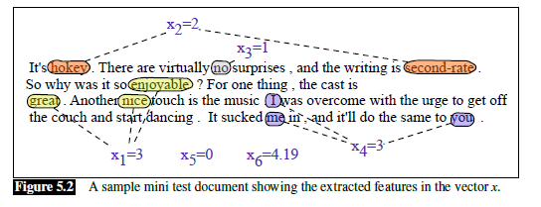
We’ll represent each input observation by the 6 features x1...x6 of the input
Assume we have a lexicon of pos and neg words
Notes:
We’ll represent each input observation by the 6 features x1...x6 of the input

Slide 23
Classifying sentiment for input x
Assume we learned the weights and their values as follws:
w =
b = 0.1
Notes:
Let’s assume for the moment that we’ve already learned a real-valued weight for each of these features, and that the 6 weights corresponding to the 6 features are as follows. The weight w1, for example indicates how important a feature the number of positive lexicon words (great, nice, enjoyable, etc.) is to a positive sentiment decision, while w2 tells us the importance of negative lexicon words. Note that w1 = 2.5 is positive, while w2 = −5.0, meaning that negative words are negatively associated with a positive sentiment decision, and are about twice as important as positive words.

Slide 24
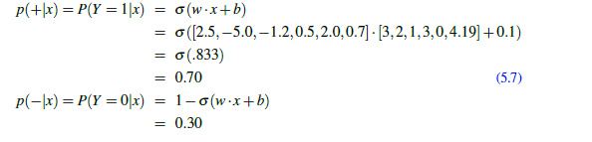
Classifying sentiment for input x
Notes:
Given these 6 features and the input review x, we can compute P(+|x) and P(−|x)

Slide 25
Classification in (binary) logistic regression: summary
Given:
a set of classes: (+ sentiment,- sentiment)
a vector x of features [x1, x2, …, xn]
x1= count( "awesome")
x2 = log(number of words in review)
A vector w of weights [w1, w2, …, wn]
w_{i} for each feature f_{i}

Slide 26
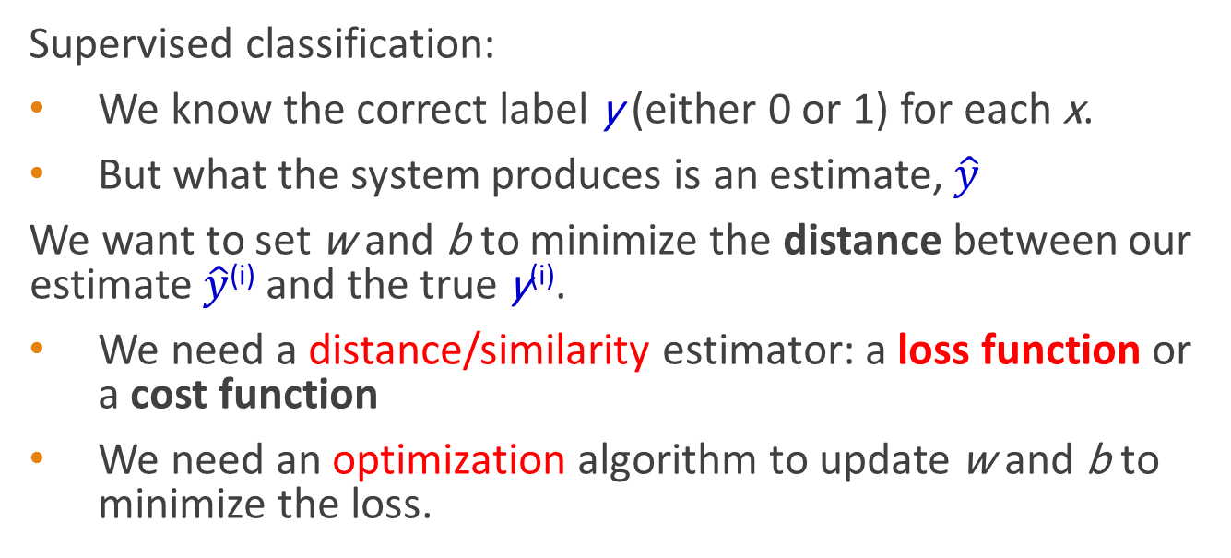
Learning parameters using cross-entropy loss
Supervised classification:
We know the correct label y (either 0 or 1) for each x.
But what the system produces is an estimate, $\hat{y}$
We want to set w and b to minimize the distance between our estimate $\hat{y}$^{(i)} and the true y^{(i)}.
We need a distance/similarity estimator: a loss function or a cost function
We need an optimization algorithm to update w and b to minimize the loss.
A loss function:
cross-entropy loss
An optimization algorithm:
stochastic gradient descent
Notes:
Logistic regression is an instance of supervised classification in which we know the correct label y (either 0 or 1) for each observation x. But what the system produces is an estimate, ^y. We want to learn parameters (meaning w and b) that make yˆ for each training observation as close as possible to the true y.

Slide 27

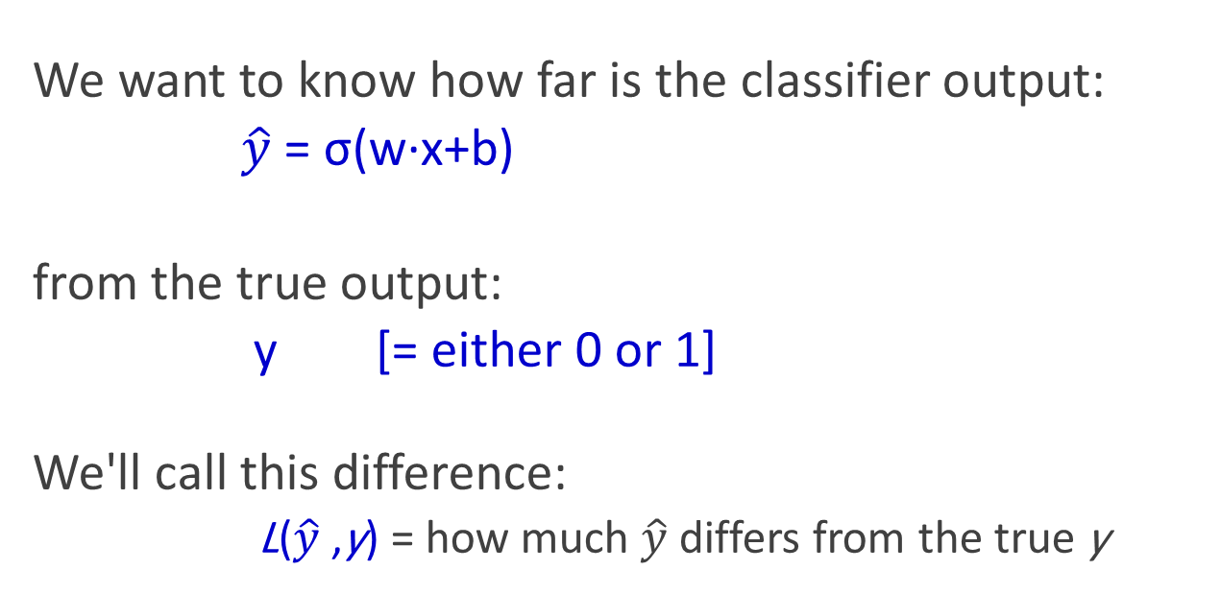
The distance between $\hat{y}$and y
We want to know how far is the classifier output:
$\hat{y}$= σ(w∙x+b)
from the true output:
y [= either 0 or 1]
We'll call this difference:
L($\hat{y}$,y) = how much $\hat{y}$ differs from the true y
Notes:
We need a loss function that expresses, for an observation x, how close the classifier output (yˆ = σ (w · x + b)) is to the correct output (y, which is 0 or 1).

Slide 28
Intuition of negative log likelihood loss = cross-entropy loss
A case of conditional maximum likelihood estimation
We choose the parameters w,b that maximize
the log probability
of the true y labels in the training data
given the observations x
Notes:
We do this via a loss function that prefers the correct class labels of the training examples to be more likely. This is called conditional maximum likelihood estimation: we choose the parameters w,b that maximize the log probability of the true y labels in the training data given the observations x. The resulting loss function is the negative log likelihood loss, generally called the cross-entropy loss.

Slide 29
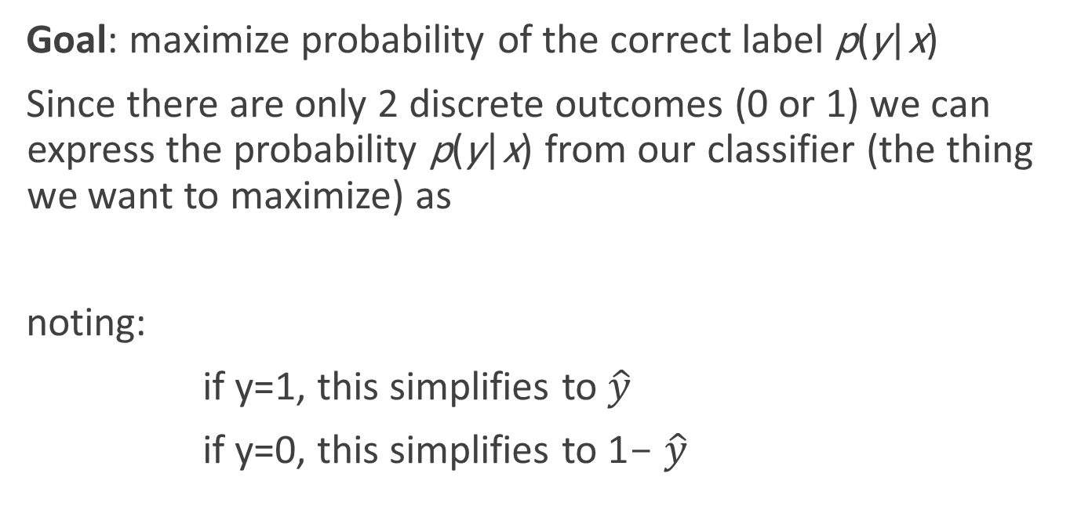
Deriving cross-entropy loss for a single observation x
Goal: maximize probability of the correct label p(y|x)
Since there are only 2 discrete outcomes (0 or 1) we can express the probability p(y|x) from our classifier (the thing we want to maximize) as
noting:
if y=1, this simplifies to $\hat{y}$
if y=0, this simplifies to 1- $\hat{y}$
Notes:
Let’s derive this loss function, applied to a single observation x. We’d like to learn weights that maximize the probability of the correct label, that's p(y|x).

Slide 30
Deriving cross-entropy loss for a single observation x
Goal: maximize probability of the correct label p(y|x)
Maximize:
Now take the log of both sides (mathematically handy)
Whatever values maximize log p(y|x) will also maximize p(y|x)
Maximize:

Slide 31
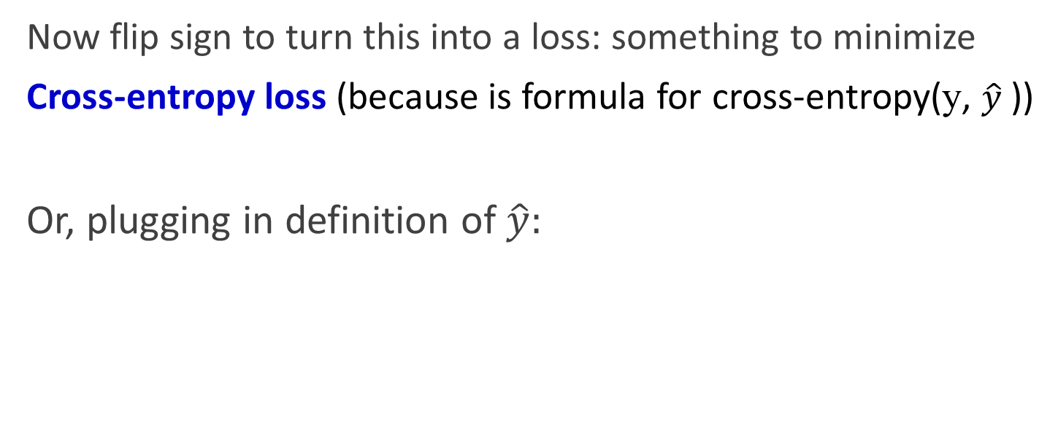
Deriving cross-entropy loss for a single observation x
Goal: maximize probability of the correct label p(y|x)
Maximize:
Now flip sign to turn this into a loss: something to minimize
Cross-entropy loss (because is formula for cross-entropy(y, $\hat{y}$))
Or, plugging in definition of $\hat{y}:$
Minimize:
Notes:
Cross entropy is a way to measure how different two probability distributions are from each other. It's often used in machine learning and statistics to compare a predicted probability distribution with the actual, or "true," probability distribution.
Imagine you have a bag of colored balls, and you want to predict the probability of picking a red ball. If the bag has 10 red balls and 90 blue balls, the true probability of picking a red ball is 0.1 (or 10%). Now imagine a machine learning model predicts the probability of picking a red ball is 0.2 (or 20%). The cross entropy between the true and predicted probability distributions measures how different these two probabilities are.
In general, cross entropy is calculated by taking the negative sum of the true probabilities multiplied by the logarithm of the predicted probabilities. The formula looks like this:
cross entropy = -sum(true probabilities * log(predicted probabilities))
In the colored ball example, we have a bag with 10 red balls and 90 blue balls. The true probability of picking a red ball is 0.1 and the true probability of picking a blue ball is 0.9. Let's say a machine learning model predicts the probability of picking a red ball is 0.2 and the probability of picking a blue ball is 0.8.
To calculate the cross entropy between the true and predicted probability distributions, we use the formula:
cross entropy = -sum(true probabilities * log(predicted probabilities))
Plugging in the values, we get:
cross entropy = -(0.1 * log(0.2) + 0.9 * log(0.8))
Using a calculator, we can evaluate the logarithmic terms to get:
cross entropy = -(0.1 * (-1.609) + 0.9 * (-0.223))
Simplifying and multiplying, we get:
cross entropy = 0.329
So the cross entropy between the true and predicted probability distributions is 0.329. This value indicates how different the predicted probabilities are from the true probabilities: the higher the cross entropy, the greater the difference between the two probability distributions.

Slide 32
Let's see if this works for our sentiment example
We want loss to be:
smaller if the model estimate is close to correct
bigger if model is confused
Let's first suppose the true label of this is y=1 (positive)
It's hokey . There are virtually no surprises , and the writing is second-rate . So why was it so enjoyable ? For one thing , the cast is great . Another nice touch is the music . I was overcome with the urge to get off the couch and start dancing . It sucked me in , and it'll do the same to you .

Slide 33
Let's see if this works for our sentiment example
True value is y=1. How well is our model doing?
Pretty well! What's the loss?

Slide 34
Let's see if this works for our sentiment example
Suppose true value instead was y=0.
What's the loss?
Notes:
By contrast, let’s pretend instead that the example was actually negative, i.e., the true y = 0 (perhaps the reviewer went on to say “But bottom line, the movie is terrible! I beg you not to see it!”) . In this case our model is confused, the model is wrong, so we’d want the loss to be higher. Let's plug in y = 0 and 1−σ(w·x+b) = .31

Slide 35
Let's see if this works for our sentiment example
The loss when model was right (if true y=1)
Is lower than the loss when model was wrong (if true y=0):
Sure enough, loss was bigger when model was wrong!

Slide 36
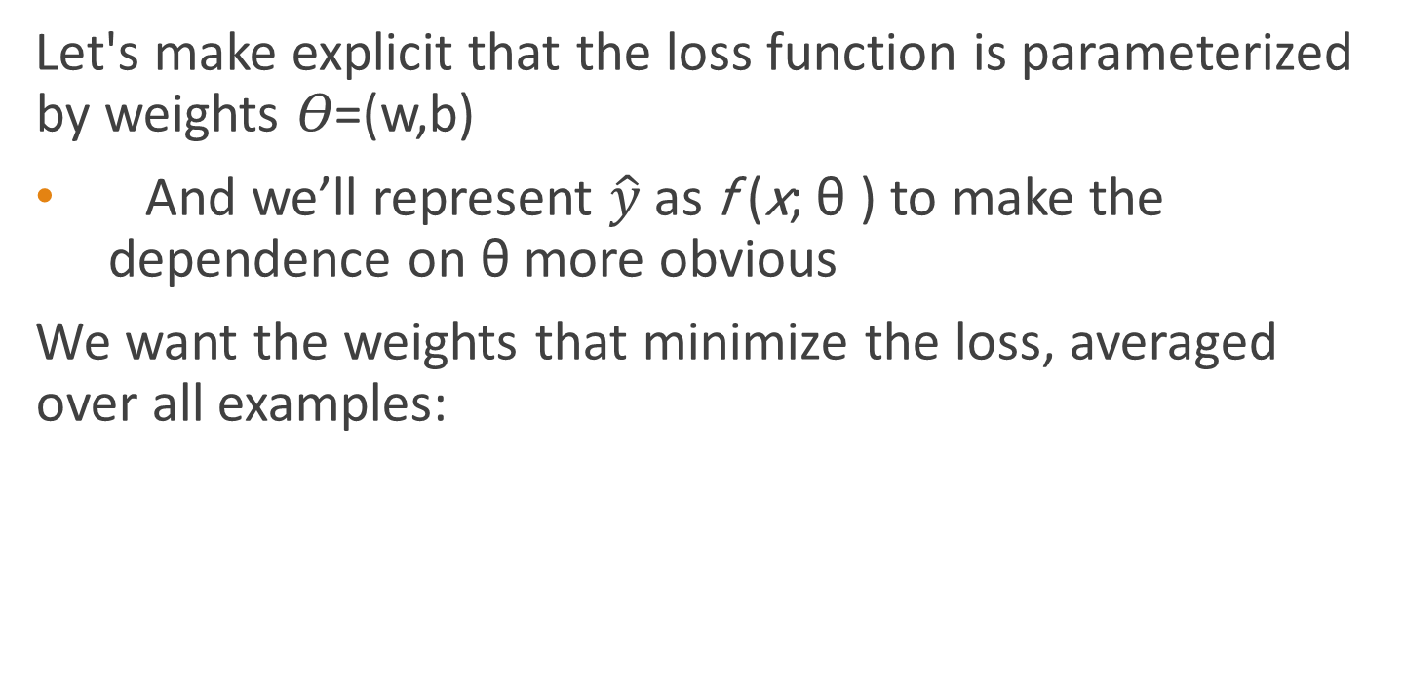
Our goal: minimize the loss
Stochastic Gradient Descent
Let's make explicit that the loss function is parameterized by weights 𝛳=(w,b)
And we’ll represent $\hat{y}$as f (x; θ ) to make the dependence on θ more obvious
We want the weights that minimize the loss, averaged over all examples:
Notes:
Our goal with gradient descent is to find the optimal weights: minimize the loss function we’ve defined for the model. We’ll explicitly represent the fact that the loss function L is parameterized by the weights, which we can refer to in machine learning in general as θ (in the case of logistic regression θ = w, b). And we’ll represent $\hat{y}$as f (x; θ ) to make the dependence on θ more obvious. So the goal is to find the set of weights which minimizes the loss function, averaged over all examples: EQ

Slide 37

Intuition of gradient descent
How do I get to the bottom of this river canyon?
Look around me 360∘
Find the direction of steepest slope down
Go that way
x
Notes:
How do we find the minimum of a loss function? Gradient descent is a method that finds a minimum of a function by figuring out in which direction (in the space of the parameters θ) the function’s slope is rising the most steeply, and moving in the opposite direction.
The intuition is that if you are hiking in a valley and trying to descend most quickly down to the river at the bottom, you might look around yourself 360 degrees, find the direction where the ground is sloping the steepest, and walk downhill in that direction.

Slide 38
Our goal: minimize the loss
For logistic regression, loss function is convex
A convex function has just one minimum
Gradient descent starting from any point is guaranteed to find the minimum
(Loss for neural networks is non-convex)
Notes:
For logistic regression, this loss function is conveniently convex. A convex function has just one minimum; there are no local minima to get stuck in, so gradient descent starting from any point is guaranteed to find the minimum. (By contrast, the loss for multi-layer neural networks is non-convex, and gradient descent may get stuck in local minima for neural network training and never find the global optimum.)

Slide 39
Let's first visualize for a single scalar w
Q: Given current w, should we make it bigger or smaller?
A: Move w in the reverse direction from the slope of the function
Notes:
Although the algorithm (and the concept of gradient) are designed for direction vectors, let’s first consider a visualization of the case where the parameter of our system is just a single scalar w. Given a random initialization of w at some value w1, and assuming the loss function L happened to have this shape, we need the algorithm to tell us whether at the next iteration we should move left (making w2 smaller than w1) or right (making w2 bigger than w1) to reach the minimum. The gradient descent algorithm answers this question by finding the gradient of the loss function at the current point and moving in the opposite direction.

Slide 40
Let's first visualize for a single scalar w
Q: Given current w, should we make it bigger or smaller?
A: Move w in the reverse direction from the slope of the function
So we'll move positive
Notes:
Thus to find the minimum, gradient descent tells us to go in the opposite direction: moving w in a positive direction.

Slide 41
Gradients
The gradient of a function of many variables is a vector pointing in the direction of the greatest increase in a function.
Gradient Descent: Find the gradient of the loss function at the current point and move in the opposite direction.

Slide 42
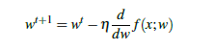
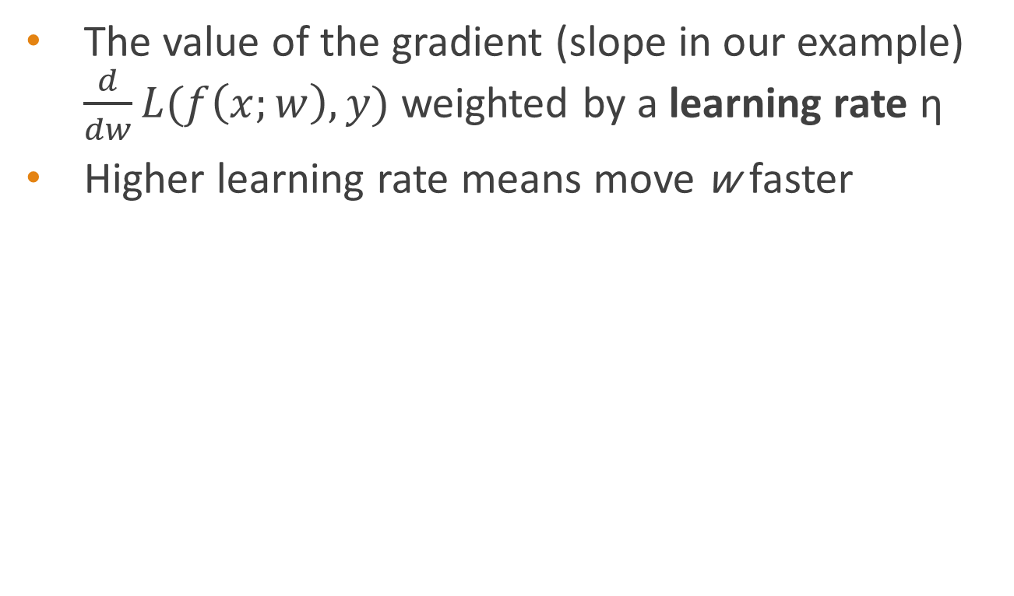
How much do we move in that direction ?
The value of the gradient (slope in our example) $\frac{d}{dw}L(f\left(x;w\right),y)$ weighted by a learning rate η
Higher learning rate means move w faster
Notes:
The magnitude of the amount to move in gradient descent is the value of the slope of the loss function (with respect to w) weighted by a learning rate η . A higher (faster) learning rate means that we should move w more on each step. The change we make in our parameter is the learning rate times the gradient (or the slope, in our single-variable example)

Slide 43
Now let's consider N dimensions
We want to know where in the N-dimensional space (of the N parameters that make up θ ) we should move.
The gradient is just such a vector; it expresses the directional components of the sharpest slope along each of the N dimensions.
Notes:
Now let’s extend the intuition from a function of one scalar variable w to many variables, because we don’t just want to move left or right, we want to know where in the N-dimensional space (of the N parameters that make up θ ) we should move. The gradient is just such a vector; it expresses the directional components of the sharpest slope along each of those N dimensions.

Slide 44
Imagine 2 dimensions, w and b
Visualizing the gradient vector at the red point
It has two dimensions shown in the x-y plane
Notes:
If we’re just imagining two weight dimensions (say for one weight w and one bias b), the gradient might be a vector with two orthogonal components, each of which tells us how much the ground slopes in the w dimension and in the b dimension. This figure shows a visualization of the value of a 2-dimensional gradient vector taken at the red point.

Slide 45
Real gradients
Are much longer; lots and lots of weights
For each dimension w_{i} the gradient component i tells us the slope with respect to that variable.
“How much would a small change in w_{i} influence the total loss function L?”
We express the slope as a partial derivative ∂ of the loss ∂w_{i}
The gradient is then defined as a vector of these partials.
Notes:
In an actual logistic regression, the parameter vector w is much longer than 1 or 2, since the input feature vector x can be quite long, and we need a weight wi for each xi. For each dimension/variable wi in w (plus the bias b), the gradient will have a component that tells us the slope with respect to that variable. Essentially we’re asking: “How much would a small change in that variable wi influence the total loss function L?” In each dimension wi, we express the slope as a partial derivative of the loss function with respect to wi. The gradient is then defined as a vector of these partials.

Slide 46
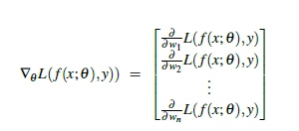
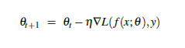
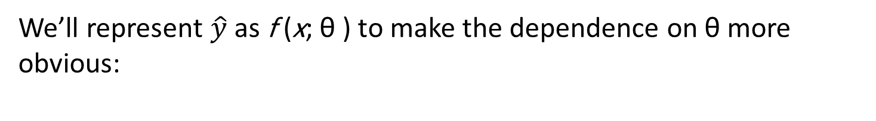
The gradient
We’ll represent $\hat{y}$as f (x; θ ) to make the dependence on θ more obvious:
The final equation for updating θ based on the gradient is thus
Notes:
Here's a vector of gradients. We’ll represent yˆ as f (x; θ ) to make the dependence on θ more obvious:

Slide 47
What are these partial derivatives for logistic regression?
The loss function
The elegant derivative of this function (see textbook 5.8 for derivation)
Notes:
In order to update θ , we need a definition for the gradient ∇L( f (x; θ ), y). Recall that for logistic regression, the cross-entropy loss function is: EQ
It turns out that the derivative of this function for one observation vector x is EQ
Note that the gradient with respect to a single weight w j represents a very intuitive value: the difference between the true y and our estimated yˆ = σ (w · x + b) for that observation, multiplied by the corresponding input value x j .

Slide 48
summary
minimize
Notes:
Stochastic gradient descent is an online algorithm that minimizes the loss function by computing its gradient after each training example, and nudging θ in the right direction (the opposite direction of the gradient). The algorithm can terminate when it converges (or when the gradient norm < ε), or when progress halts (for example when the loss starts going up on a held-out set).

Slide 49
Hyperparameters
The learning rate η is a hyperparameter
too high: the learner will take big steps and overshoot
too low: the learner will take too long
Hyperparameters:
Briefly, a special kind of parameter for an ML model
Instead of being learned by algorithm from supervision (like regular parameters), they are chosen by algorithm designer.
Notes:
The learning rate η is a hyperparameter that must be adjusted. If it’s too high, the learner will take steps that are too large, overshooting the minimum of the loss function. If it’s too low, the learner will take steps that are too small, and take too long to get to the minimum. It is common to start with a higher learning rate and then slowly decrease it. Hyperparameters are a special kind of parameter for any machine learning model. Unlike regular parameters of a model (weights like w and b), which are learned by the algorithm from the training set, hyperparameters are special parameters chosen by the algorithm designer that affect how the algorithm works.

Slide 50
Stochastic Gradient Descent: An example and more details
One step of gradient descent
A mini-sentiment example, where the true y=1 (positive)
Two features:
x₁ = 3 (count of positive lexicon words)
x₂ = 2 (count of negative lexicon words)
Assume 3 parameters (2 weights and 1 bias) in Θ⁰ are zero:
w₁ = w₂ = b = 0
η = 0.1
Notes:
Let’s walk though a single step of the gradient descent algorithm. We’ll use a simplified version of our sentiment classification example as it sees a single observation x, whose correct value is y = 1 (this is a positive review), and with only two features: x1 = 3 (count of positive lexicon words), and x2 = 2 (count of negative lexicon words). Let’s assume the initial weights and bias in θ_0 are all set to 0, and the initial learning rate η is 0.1:

Slide 51
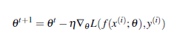
Example of gradient descent
w₁ = w₂ = b = 0;
x₁ = 3; x₂ = 2
Update step for update θ is:
where
Gradient vector has 3 dimensions:

Slide 52
Example of gradient descent
Now that we have a gradient, we compute the new parameter vector θ¹ by moving θ⁰ in the opposite direction from the gradient:
η = 0.1;
Note that enough negative examples would eventually make w₂ negative
Notes:
Note that this observation x happened to be a positive example. We would expect that after seeing more negative examples with high counts of negative words, that the weight w2, the weight for the "negative lexicon feature', would shift to have a negative value.

Slide 53
Mini-batch training
Stochastic gradient descent chooses a single random example at a time.
That can result in choppy movements
More common to compute gradient over batches of training instances.
Batch training: entire dataset
Mini-batch training: m examples (512, or 1024)
Notes:
Stochastic gradient descent is called stochastic because it chooses a single random example at a time, moving the weights so as to improve performance on that single example. That can result in very choppy movements, so it’s common to compute the gradient over batches of training instances rather than a single instance.
For example in batch training we compute the gradient over the entire dataset. By seeing so many examples, batch training offers a superb estimate of which direction to move the weights, at the cost of spending a lot of time processing every single example in the training set to compute this perfect direction.
A compromise is mini-batch training: we train on a group of m examples (perhaps 512, or 1024) that is less than the whole dataset.
Mini-batch training also has the advantage of computational efficiency. The mini-batches can easily be vectorized, choosing the size of the mini-batch based on the computational resources. This allows us to process all the exam- ples in one mini-batch in parallel and then accumulate the loss, something that’s not possible with individual or batch training.

Slide 54
Overfitting
Regularization
A model that perfectly match the training data has a problem.
It will also overfit to the data, modeling noise
A random word that perfectly predicts y (it happens to only occur in one class) will get a very high weight.
Failing to generalize to a test set without this word.
A good model should be able to generalize

Slide 55
Overfitting
Useful or harmless features
+
X1 = "this"
X2 = "movie
X3 = "hated"
This movie drew me in, and it'll do the same to you.
X4 = "drew me in"
-
4gram features that just "memorize" training set and might cause problems
I can't tell you how much I hated this movie. It sucked.
X5 = "the same to you"
X7 = "tell you how much"

Slide 56
Overfitting
4-gram model on tiny data will just memorize the data
100% accuracy on the training set
But it will be surprised by the novel 4-grams in the test data
Low accuracy on test set
Models that are too powerful can overfit the data
Fitting the details of the training data so exactly that the model doesn't generalize well to the test set
How to avoid overfitting?
Regularization in logistic regression
Dropout in neural networks

Slide 57
Regularization
A solution for overfitting
Add a regularization term R(θ) to the loss function (for now written as maximizing logprob rather than minimizing loss)
Idea: choose an R(θ) that penalizes large weights
fitting the data well with lots of big weights not as good as fitting the data a little less well, with small weights

Slide 58
L2 Regularization (= ridge regression)
The sum of the squares of the weights
The name is because this is the (square of the) L2 norm ||θ||₂, = Euclidean distance of θ to the origin.
L2 regularized objective function:

Slide 59
L1 Regularization (= lasso regression)
The sum of the (absolute value of the) weights
Named after the L1 norm ||W||₁, = sum of the absolute values of the weights, = Manhattan distance
L1 regularized objective function:

Slide 60
Multinomial Logistic Regression
Often we need more than 2 classes
Positive/negative/neutral
Parts of speech (noun, verb, adjective, adverb, preposition, etc.)
Classify emergency SMSs into different actionable classes
If >2 classes we use multinomial logistic regression
= Softmax regression
= Multinomial logit
= (defunct names : Maximum entropy modeling or MaxEnt
So "logistic regression" will just mean binary (2 output classes)

Slide 61
Multinomial Logistic Regression
The probability of everything must still sum to 1
P(positive|doc) + P(negative|doc) + P(neutral|doc) = 1
Need a generalization of the sigmoid called the softmax
Takes a vector z = [z1, z2, ..., zk] of k arbitrary values
Outputs a probability distribution
each value in the range [0,1]
all the values summing to 1

Slide 62
The softmax function
Turns a vector z = [z₁, z₂, ... , z_{k}] of k arbitrary values into probabilities

Slide 63
The softmax function
Turns a vector z = [z₁,z₂,...,z_{k}] of k arbitrary values into probabilities

Slide 64
Softmax in multinomial logistic regression
Input is still the dot product between weight vector w and input vector x
But now we’ll need separate weight vectors for each of the K classes.

Slide 65
Features in binary versus multinomial logistic regression
Binary: positive weight → y=1 neg weight → y=0
Multinominal: separate weights for each class:
w₅ = 3.0

